Slide 1
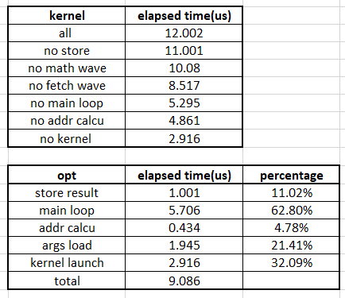
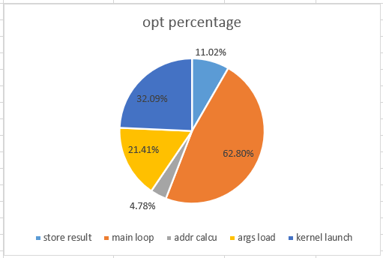
480 * 512 kernel analysis
Different Operations percentage

Slide 2
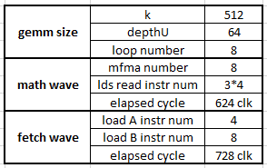
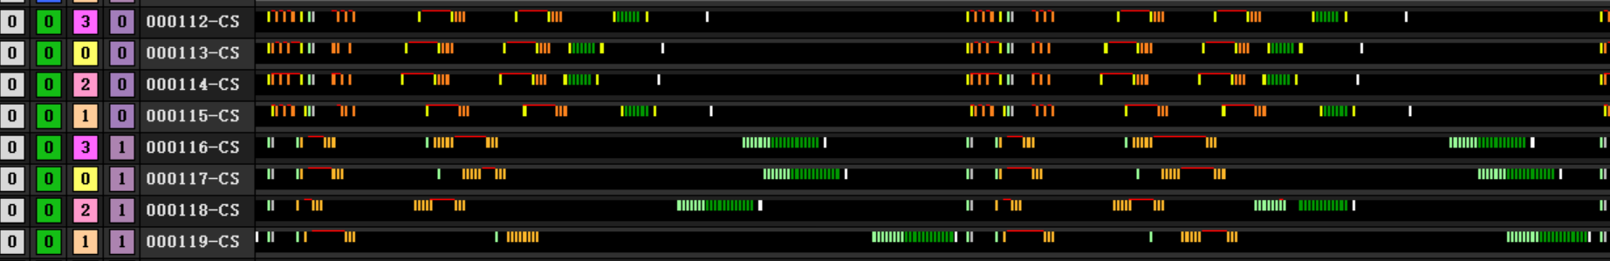
480 * 512 kernel analysis
Main loop elapsed time
3bubbles
88 clk between buff_load_A and buffer_load_B (13.7%)
300 clk between buff_load and addr calcu (41.2%)
Math wave waits fetch wave 280 clk (38.5%)
3
1
2

Slide 3
480 * 512 kernel analysis
Main loop elapsed time
3bubbles
88 clk between buff_load_A and buffer_load_B (13.7%)
300 clk between buff_load and addr calcu (41.2%)
Math wave waits fetch wave 280 clk (38.5%)
3
1
2

Slide 4
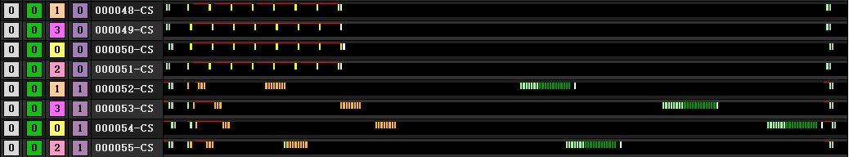
480 * 512 kernel analysis
Bottle neck of main loop
Remove all lds read instr. In math wave.
Lds read will not effect lds write in fetch wave
All mfma instr are 32 clk interval
Main loop elapsed time: 800clk
Mfma cycle: 252clk = 28(branch) + 7*32(mfma16)
Math wave waits fetch wave (bubble 3) : 284clk → 536 clk
Bottle neck : fetch wave not math wave
3

